Slide 1

ENGINEERING CHEMISTRY
Asha A
Department of Science and Humanities

Slide 2

ENGINEERING CHEMISTRY
Module 5- Energy storage devices
Module content:
Batteries
Components and working of a battery
Battery characteristics
Modern batteries
Zinc Air battery
Lithium batteries
Li-ion battery (LiCoO₂)
Reserve batteries
Fuel cells
Principle , working and Efficiency of fuel cells
Types of Fuel cells
H₂-O₂ alkaline fuel cell
CO-O₂ solid oxide fuel cell
CH₃OH-O₂ polymer membrane fuel cell
Oxygen sensors
Super capacitors
Ragone plot

Slide 3
ENGINEERING CHEMISTRY
Module 5- Energy storage devices - Batteries
Class content:
Batteries
Components of a battery
Working of a battery
Battery characteristics

Slide 4
ENGINEERING CHEMISTRY
Module 5- Energy Storage devices- Batteries
Battery
Device which stores chemical energy and converts it into electrical energy on demand
Alternate sources of energy
Variable sizes and shapes
Portable
Applications : Consumer goods - mobiles, laptops ,
calculators, flash lights
emergency lighting, space vehicles, electric vehicles,
pacemakers

Slide 5
ENGINEERING CHEMISTRY
Module 5- Energy Storage devices- Batteries
Components of a battery
Anode : Oxidation takes place
Electroactive material : metals which can undergo oxidation easily
Zn, Pb, Li
Cathode : Reduction takes place
Electroactive material : compounds which can undergo reduction easily
PbO₂, MnO₂, O₂
Electrolyte: Substance with good ionic conductivity
Acid, alkali or salt solutions; solids- doped oxides, polymers
H₂SO₄, KOH, Nafion
Separator: Insulator which separates anode and cathode compartment
Role - To prevent internal short circuit
Transport ions from anode to cathode compartments and vice versa
Polypropylene, Cellophane

Slide 6
ENGINEERING CHEMISTRY
Module 5- Energy Storage devices- Batteries
Schematic diagram of a battery

Slide 7
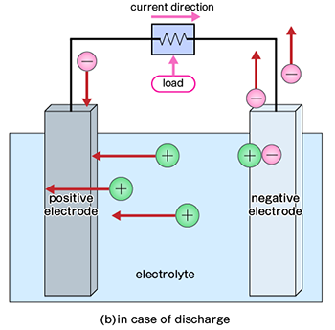
ENGINEERING CHEMISTRY
Module 5- Energy Storage devices- Batteries
Working of a battery
While discharging :
Delivers power
Galvanic cell
Anode: M → M^{n+} + ne⁻
Cathode: A + ne⁻ → A^{n-}
Overall : M + A → MA
https://www.matsusada.com/column/secondary-battery.html

Slide 8
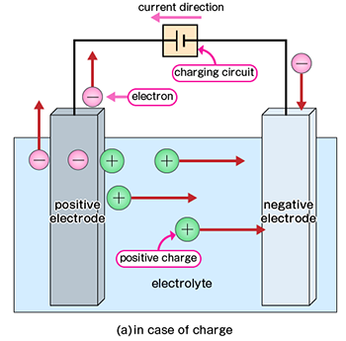
ENGINEERING CHEMISTRY
Module 5- Energy Storage devices- Batteries
Working of a battery
While charging:
Consumes power
Electrolytic cell
Anode: A^{n-} ⇌ A + ne⁻
Cathode: M^{n+} + ne⁻ ⇌ M
Overall : MA → M + A
https://www.matsusada.com/column/secondary-battery.html

Slide 9
ENGINEERING CHEMISTRY
Module 5- Energy Storage devices- Batteries
Based on working, two types of batteries:
Primary battery
Electroactive material cannot be regenerated
Discarded after electroactive species is consumed
Galvanic cell
Dry cell, Li-MnO₂
Secondary battery
Electroactive material can be regenerated
Can be used several times
Galvanic as well as electrolytic cell
Storage battery
Li-ion, Pb-acid, Ni-Cd

Slide 10
ENGINEERING CHEMISTRY
Module 5- Energy Storage devices- Batteries
Reserve batteries
One of the key component is kept separated from the rest of the battery and allowed to come in contact with other components when required
Usually the electrolyte is the component that is isolated
When one of the key components of the cell is separated from the rest of the cell, chemical reaction between the cell components (self discharge) is prevented
Has unlimited shelf life
Usually designed for emergency use e.g mid-air crisis

Slide 11
ENGINEERING CHEMISTRY
Module 5- Energy Storage devices- Batteries
Salient features of Reserve Batteries:
Quick activation
Deliver high power for a short time - many kW for
several minutes
No self-discharge
Unlimited cycle life - upto 10 years
High reliability
Examples : Mg-AgCl(water activated) , Zn-Ag₂O(KOH
activated)

Slide 12
ENGINEERING CHEMISTRY
Module 5- Energy Storage devices- Batteries
Applications:
Sonobuoys Electric torpedoes
Weather balloons Air-sea rescue equipment Pyrotechnic devices Marine markers
Emergency lights

Slide 13

ENGINEERING CHEMISTRY
Module 5- Energy Storage devices- Batteries
Battery characteristics
Voltage:
Emf of the cell → Δ G → reaction → choice of electrodes
Factors affecting voltage of a battery:
Eº_{cell} ; higher the difference between Eº_{cathode} and Eº_{anode ,} higher is the
voltage of the cell
Temperature (T) ; with increase in temperature voltage of the cell decreases
Reaction quotient (Q) ;as the value of Q increases, the voltage of the cell changes marginally

Slide 14
ENGINEERING CHEMISTRY
Module 5- Energy Storage devices- Batteries
Current:
Measure of the rate at which battery is discharging
Amperes, milliamperes
Depends on rapid electron transfer reaction
Amount of electroactive species
Conductivity of electrolyte
Inter-electrode distance

Slide 15
THANK YOU
Asha A
Department of Science and Humanities

